Slide 1
214 Woodard
Search Warrant

Slide 2
Complaint Received
Initial Letter sent 6/15/16
Final Letter sent 7/14/16 – Returned not claimed
Probable Cause Affidavit prepared 8/19/16
Search Warrant obtained and executed 8/23/16
Unsafe Building Placard put up 8/23/16
Board Letter prepared and mailed 8/29/16

Slide 3
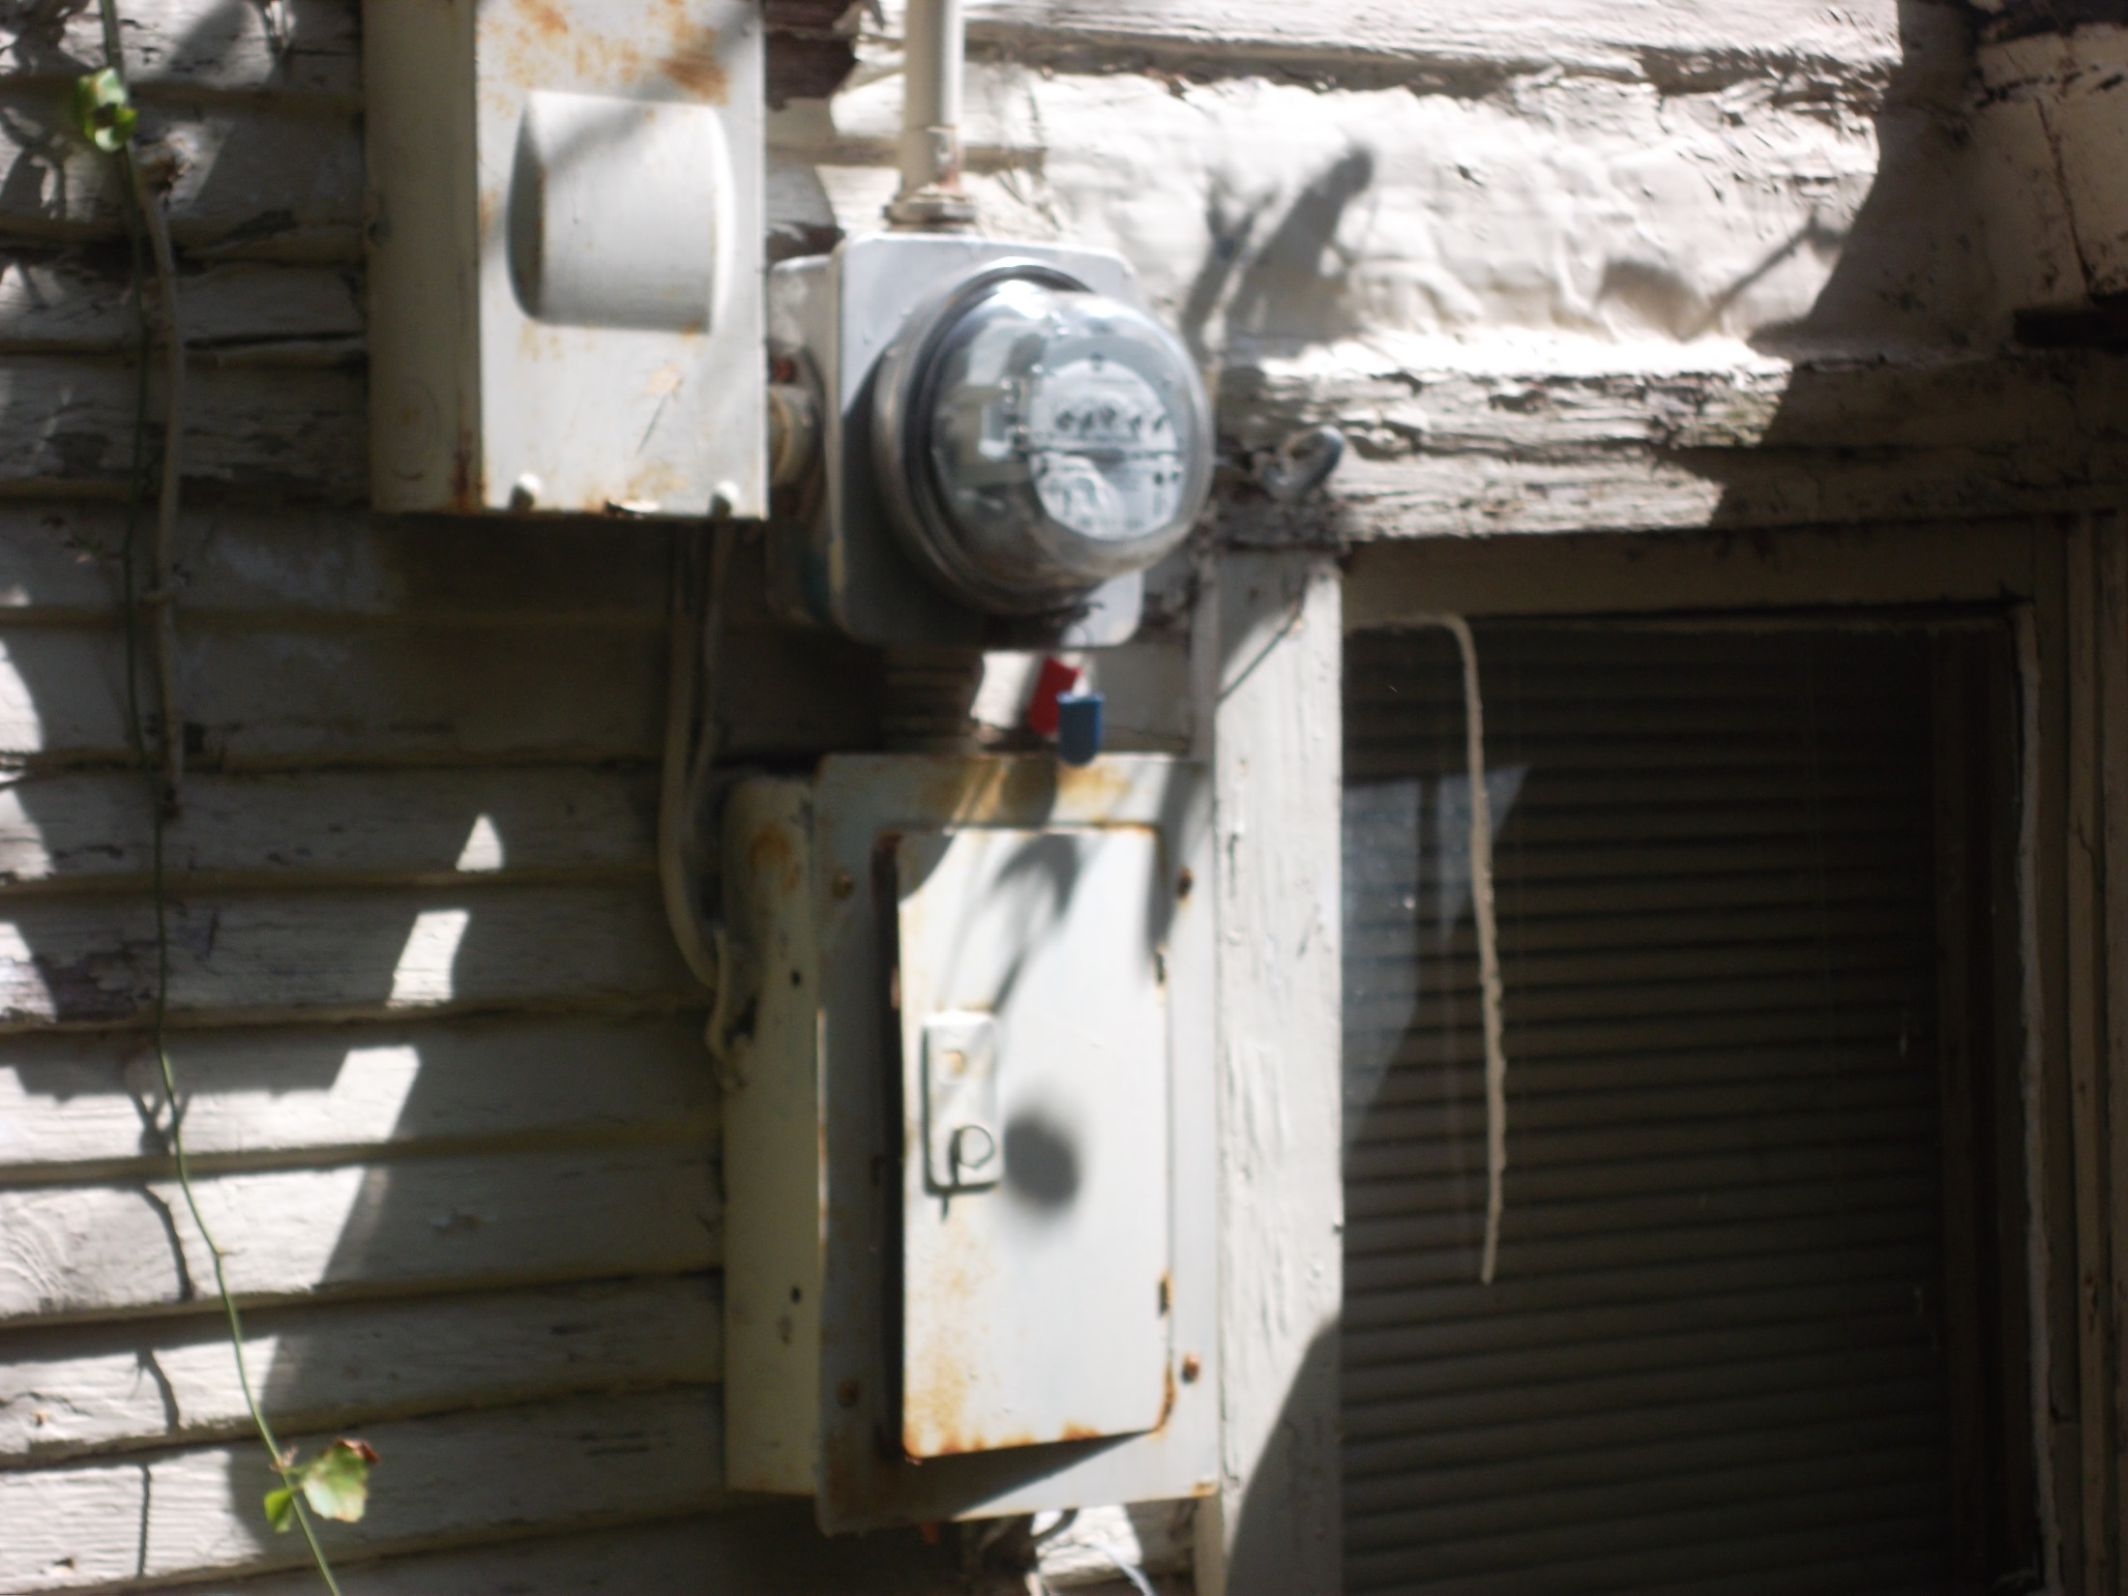
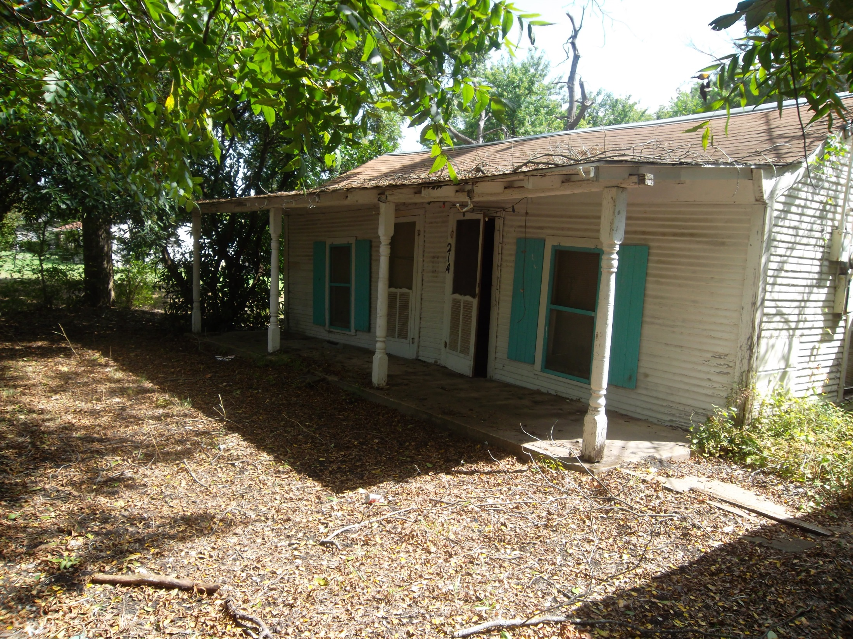

Slide 4
INSPECTOR’S FINDINGS
Rotting Siding at extensions
Pier and Beam foundation not level and resting on grade
Extensive rotting - joists and subfloors
Back section of roof appears to be falling in
Ceiling falling in throughout the house
Electrical service not up to code
No operable restroom facility
Carport rotting and falling in
This property is not habitable

Slide 5
Electric Box

Slide 6
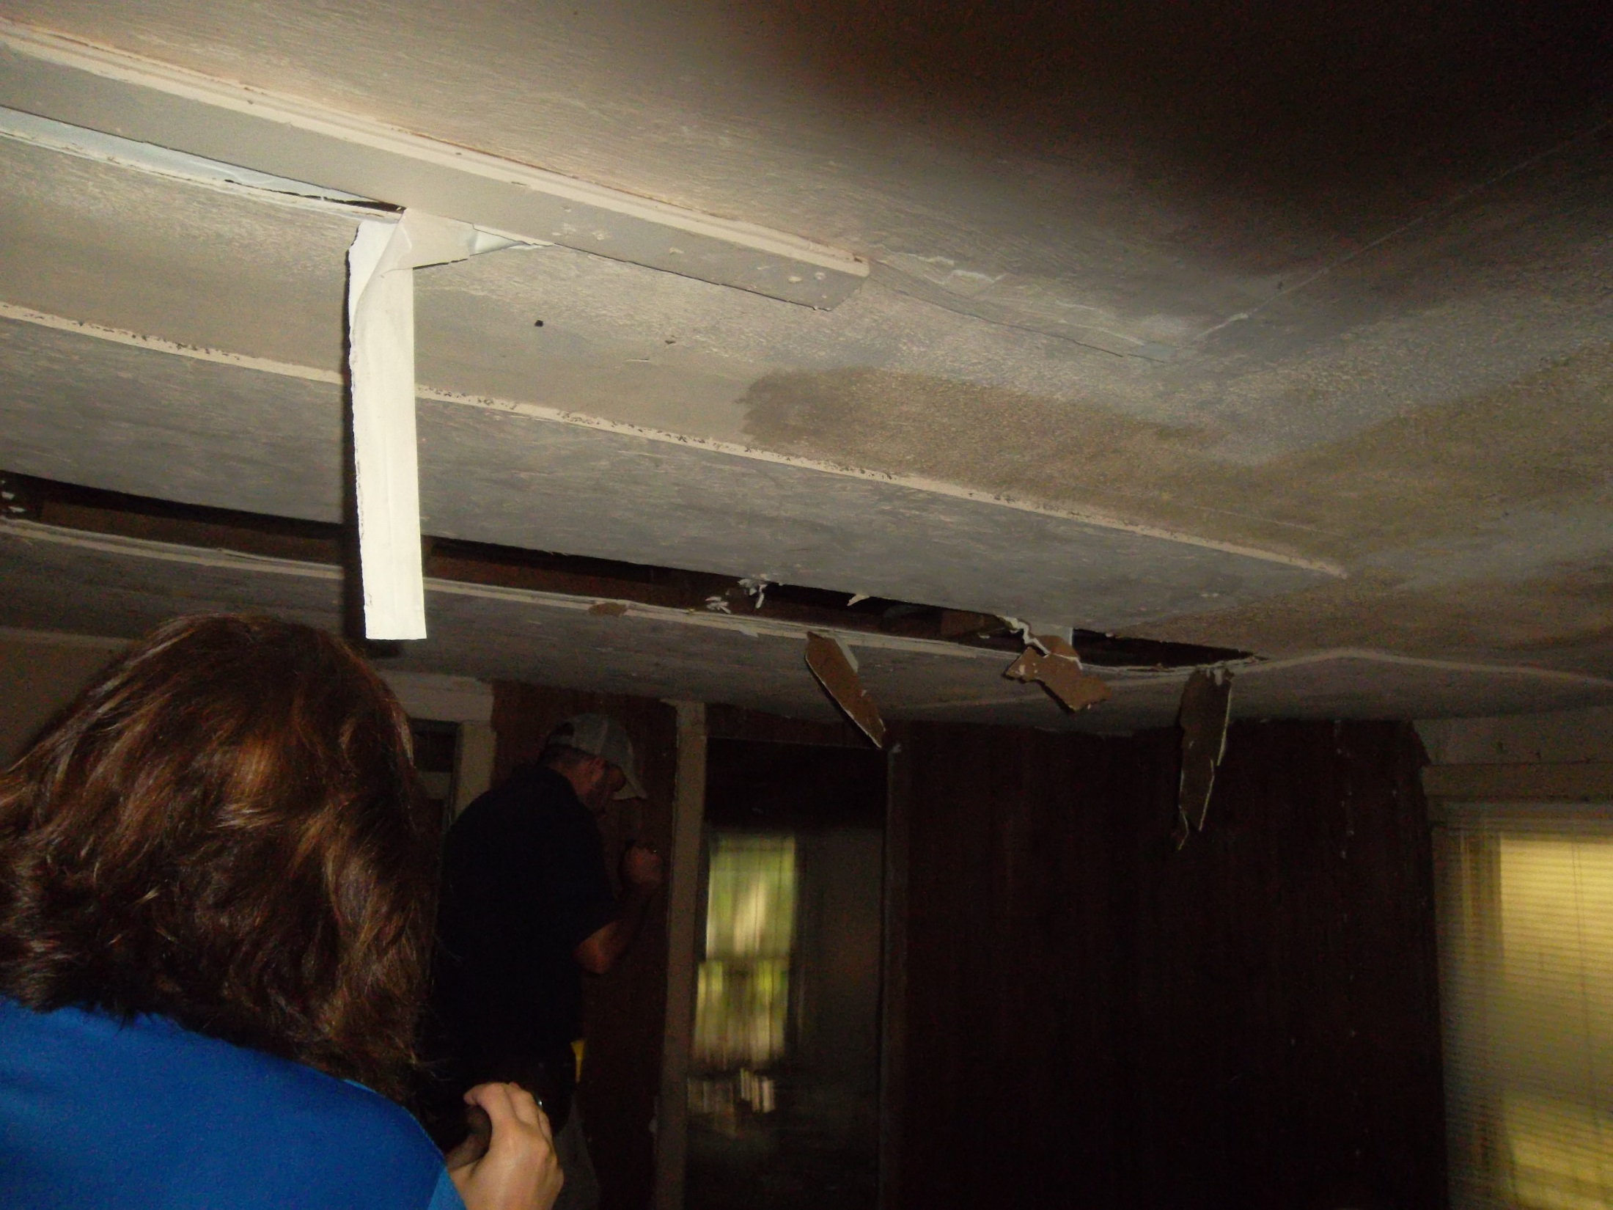
Living Room Ceiling

Slide 7
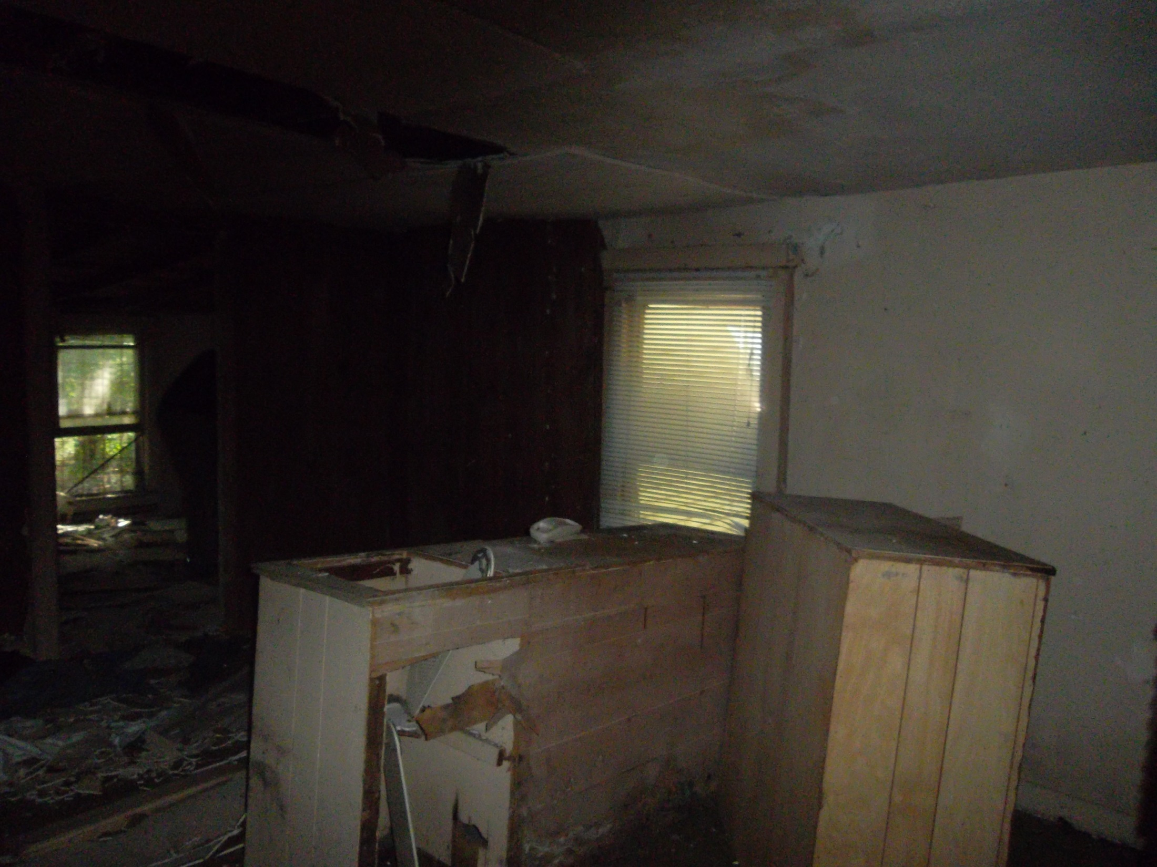
Living Room

Slide 8
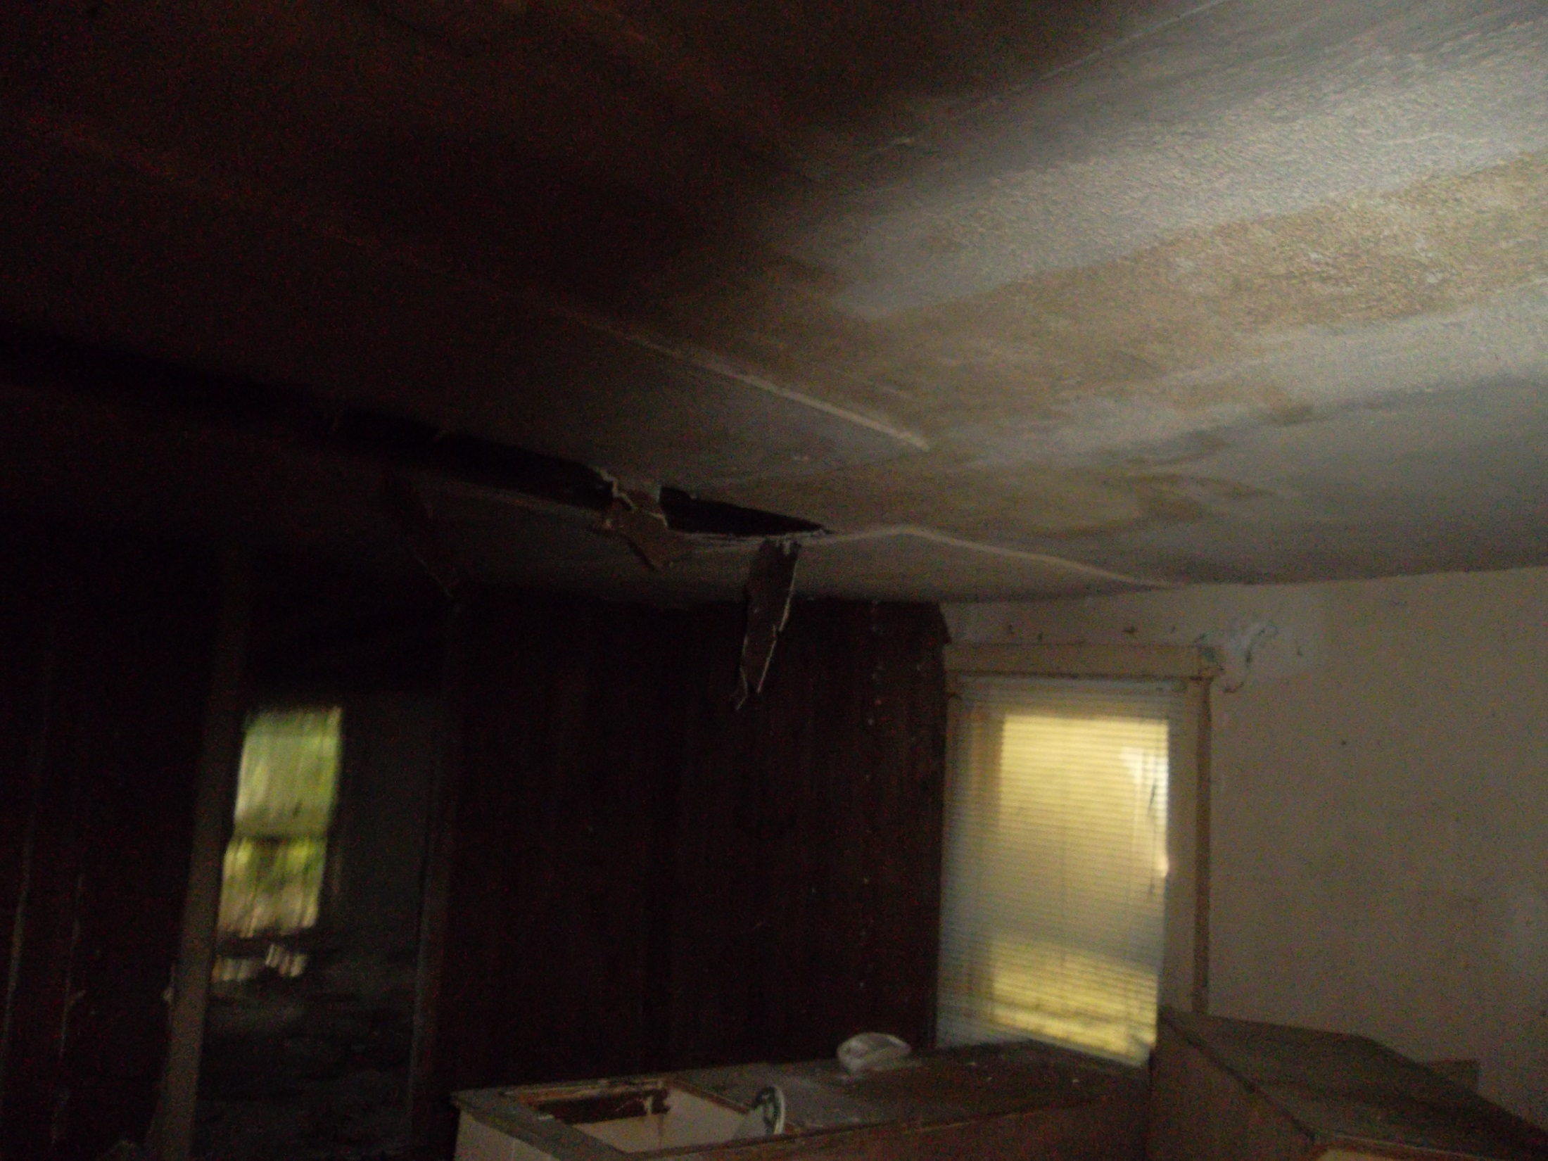
Living Room

Slide 9
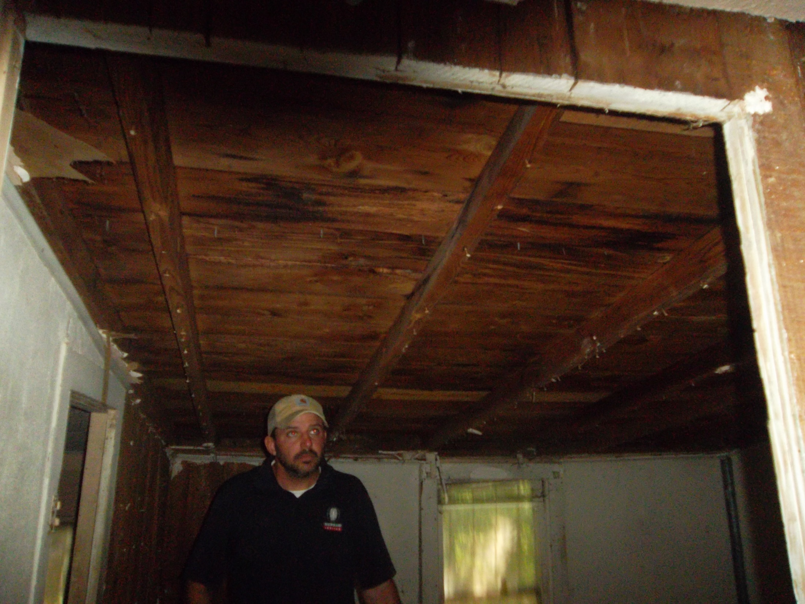
Back Room

Slide 10
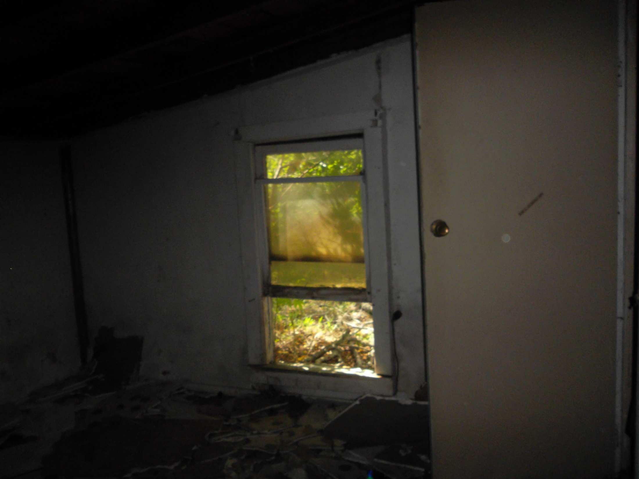
Back Room

Slide 11
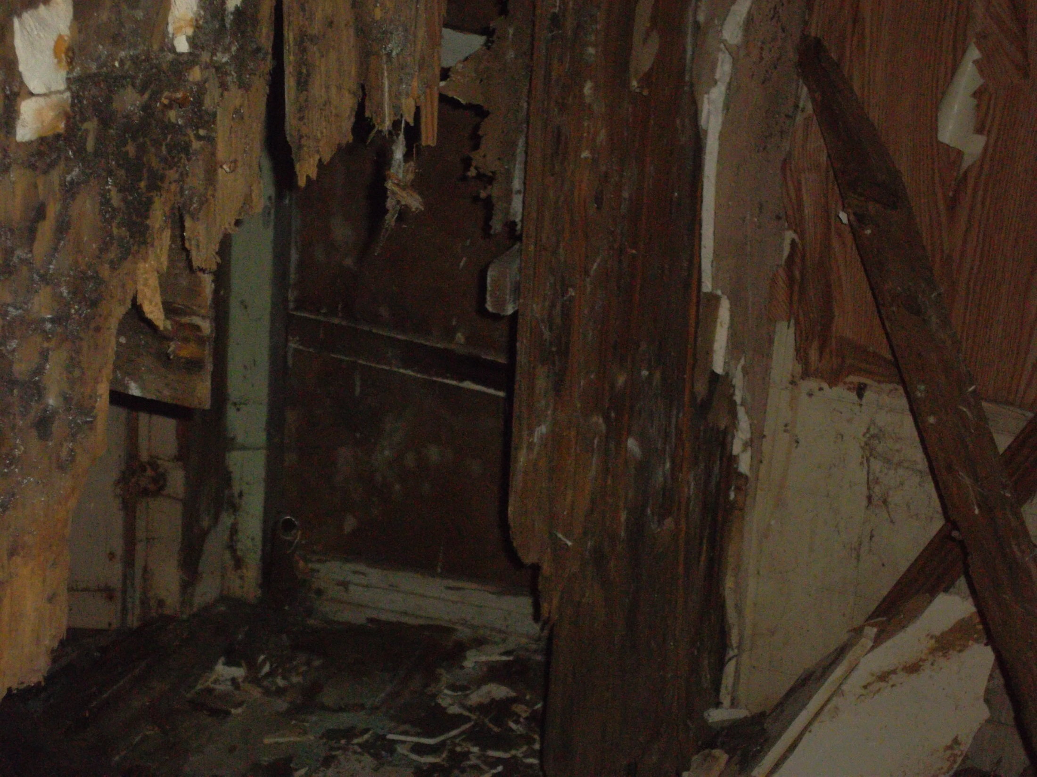
Back Room

Slide 12
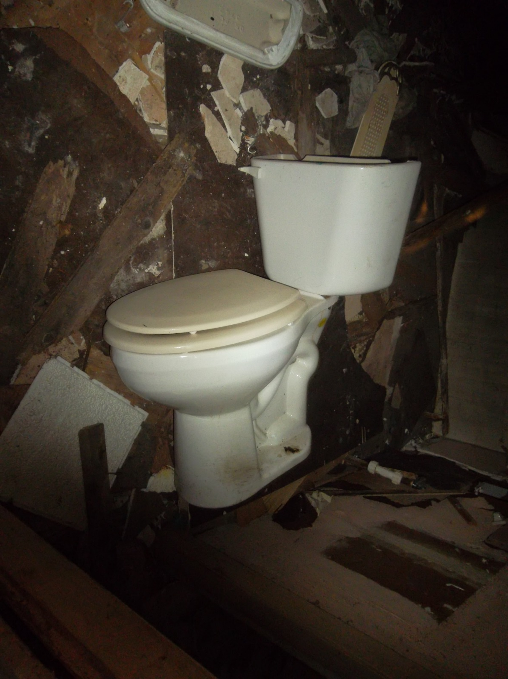
Bath Room

Slide 13
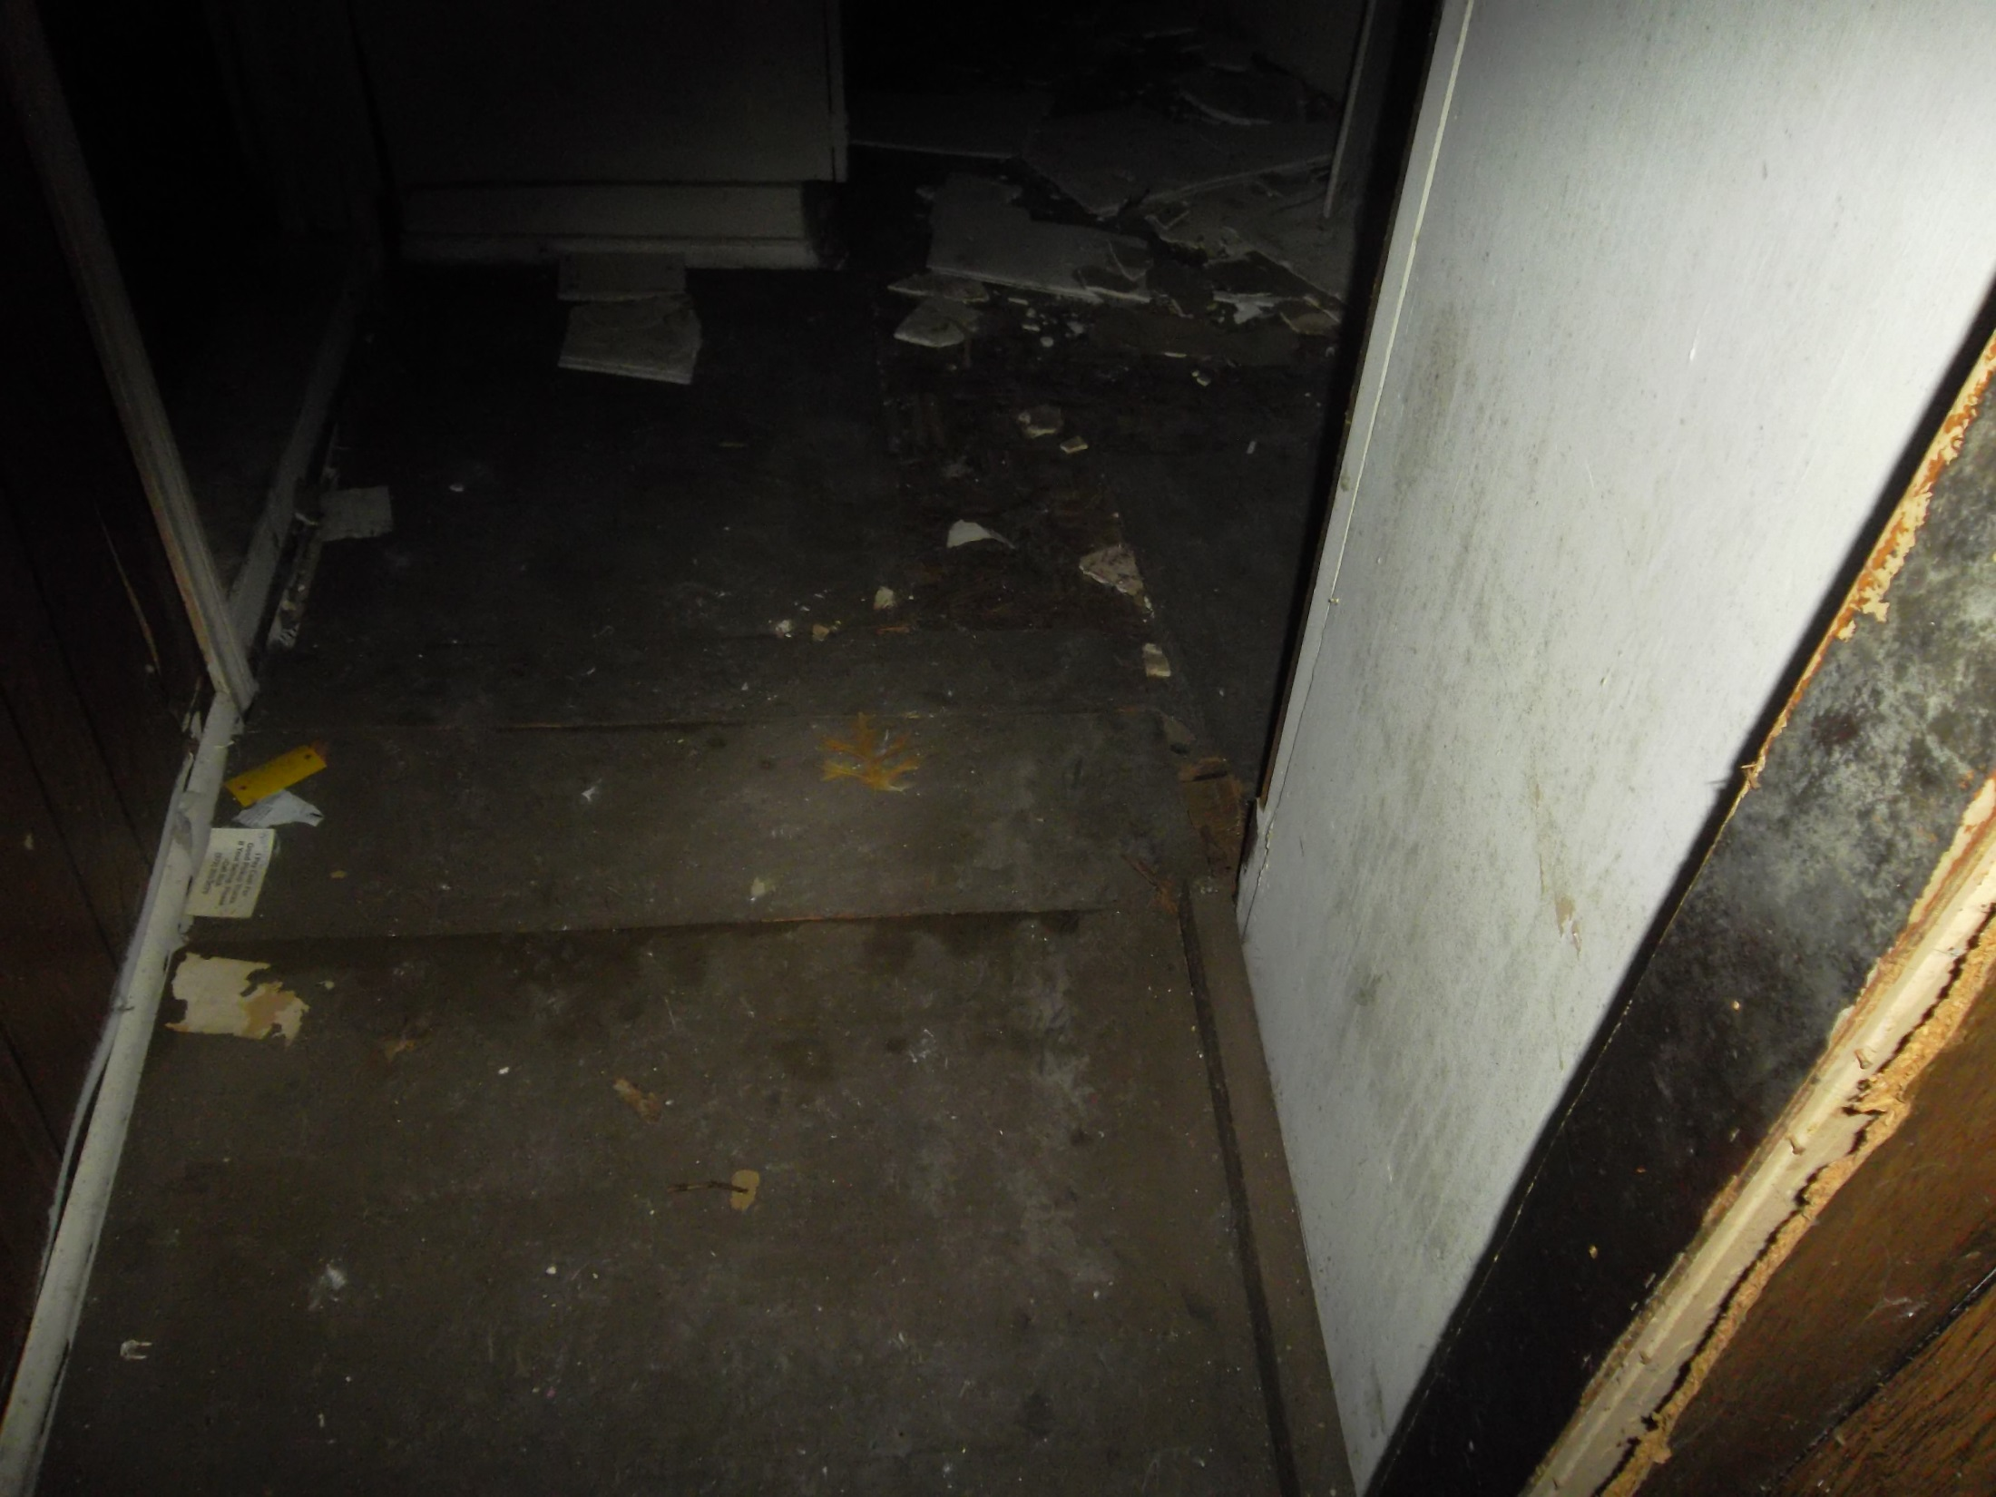
Hall Area

Slide 14
Bath Room/Dining Area

Slide 15
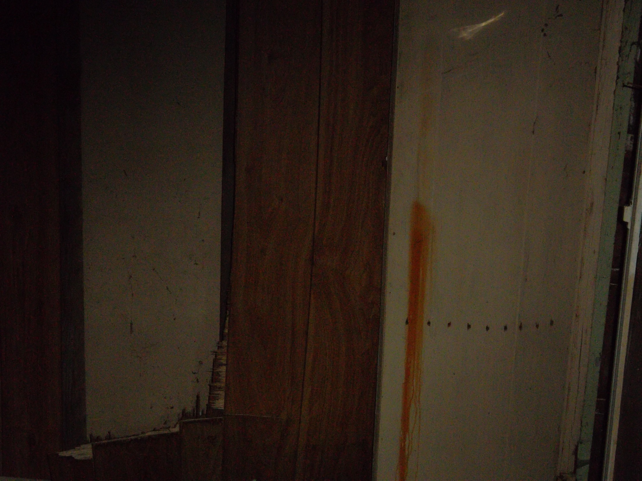
Kitchen/Dining Room

Slide 16
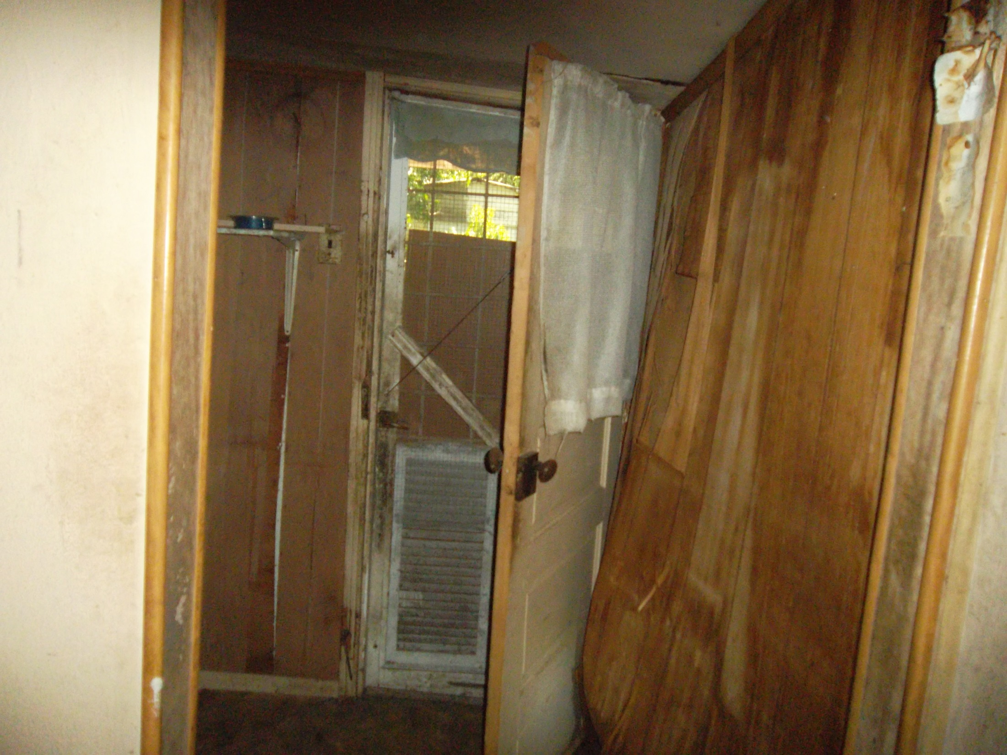
Laundry Room

Slide 17
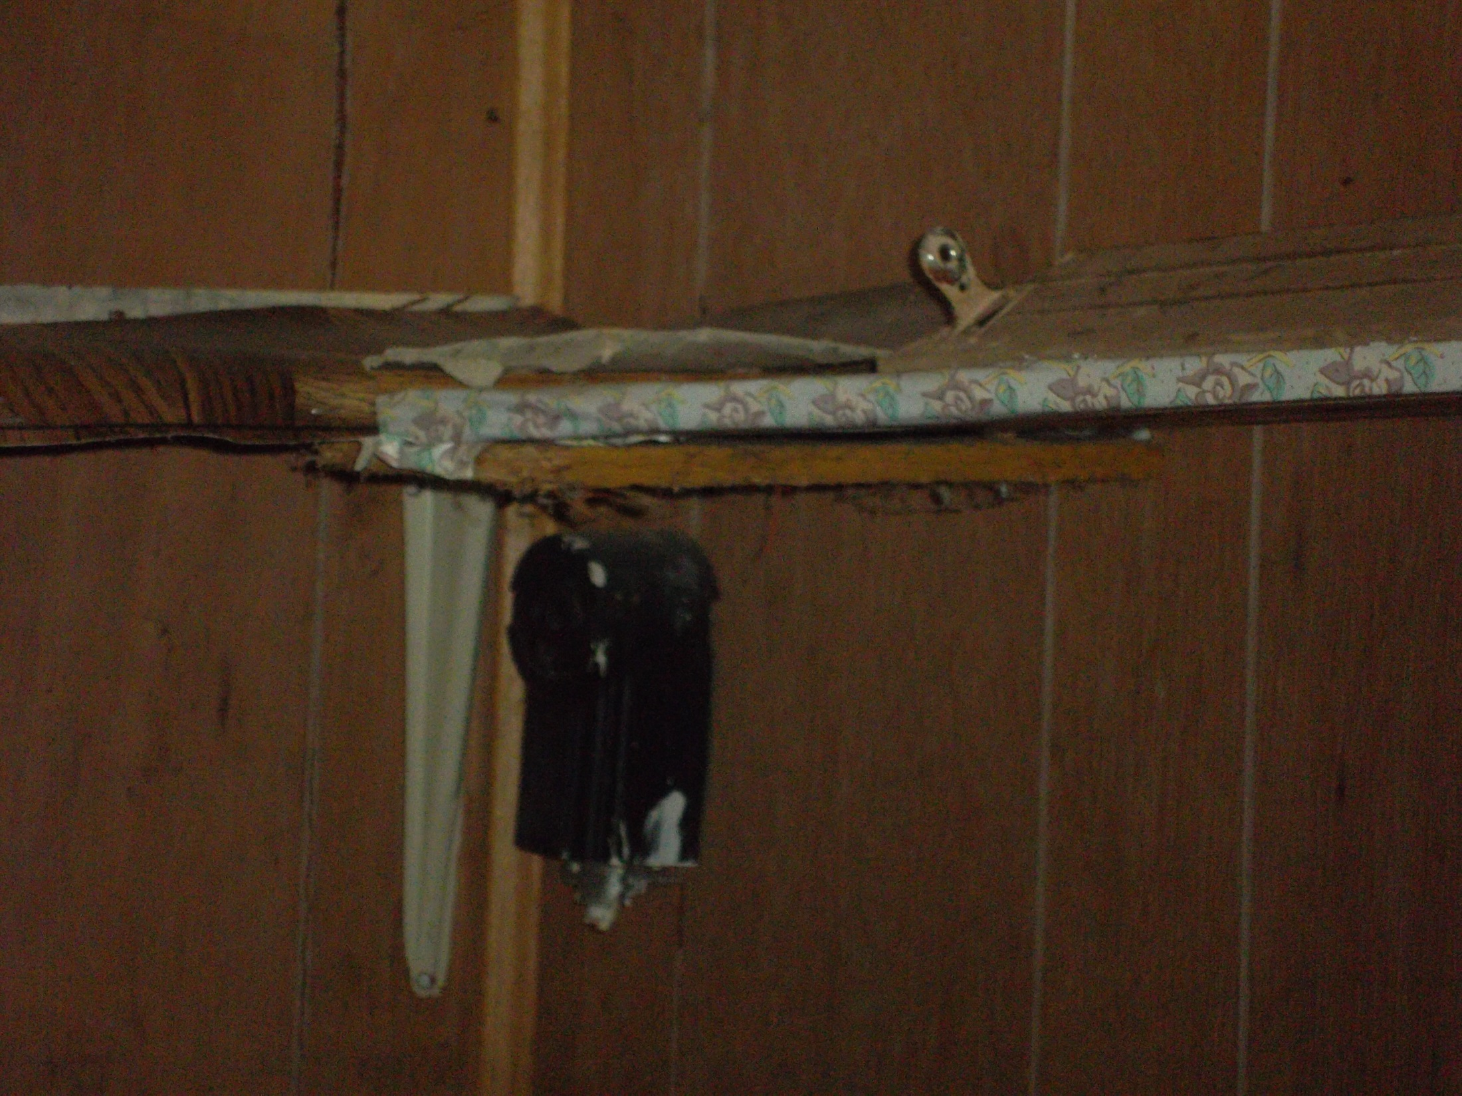
Laundry Room

Slide 18
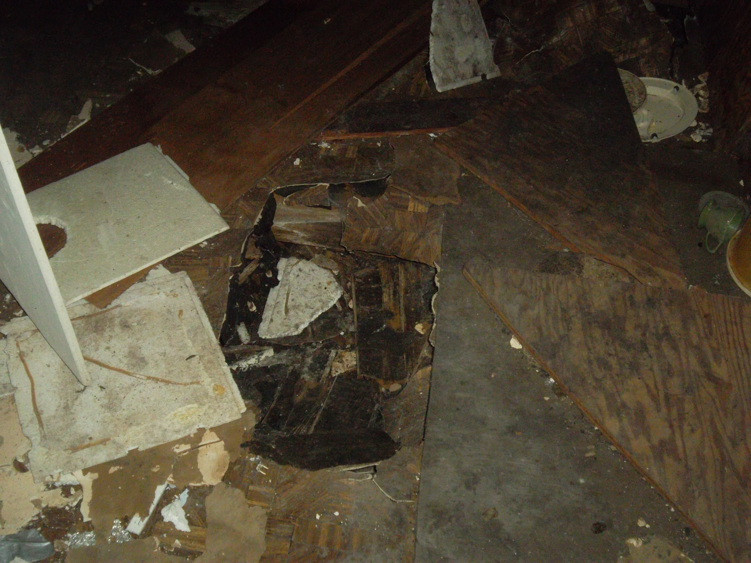
Kitchen/Dining Room

Slide 19
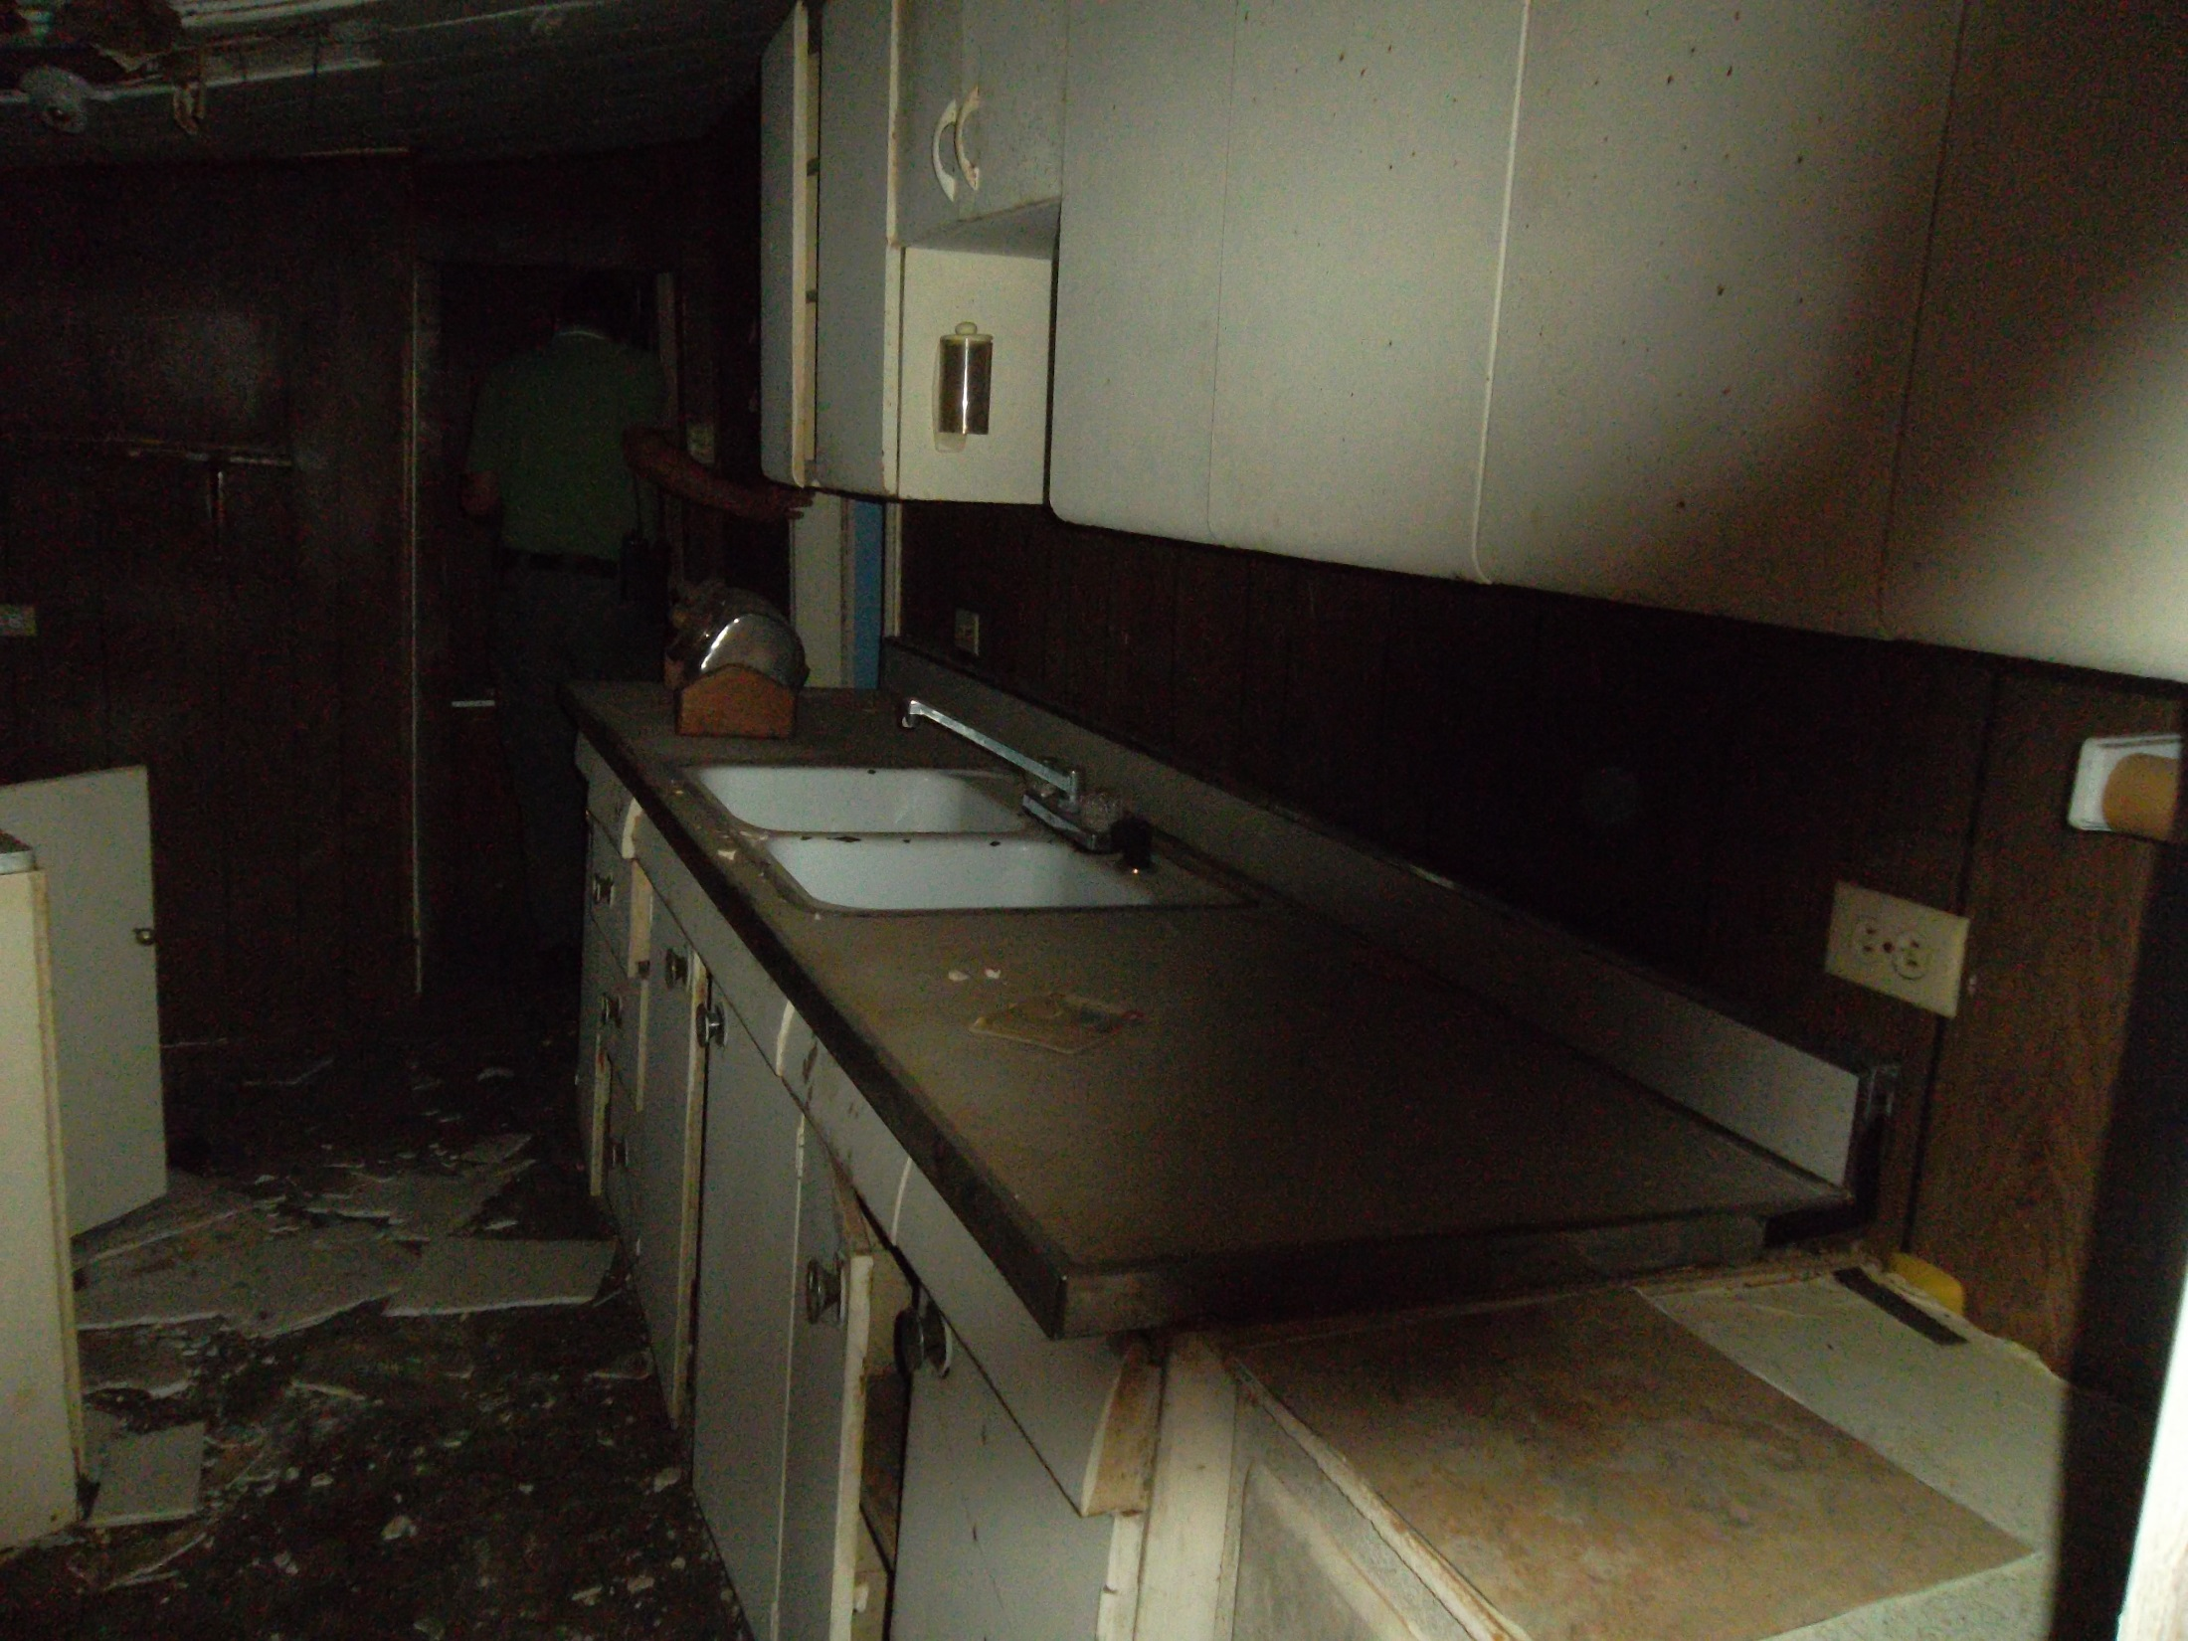
Kitchen

Slide 20
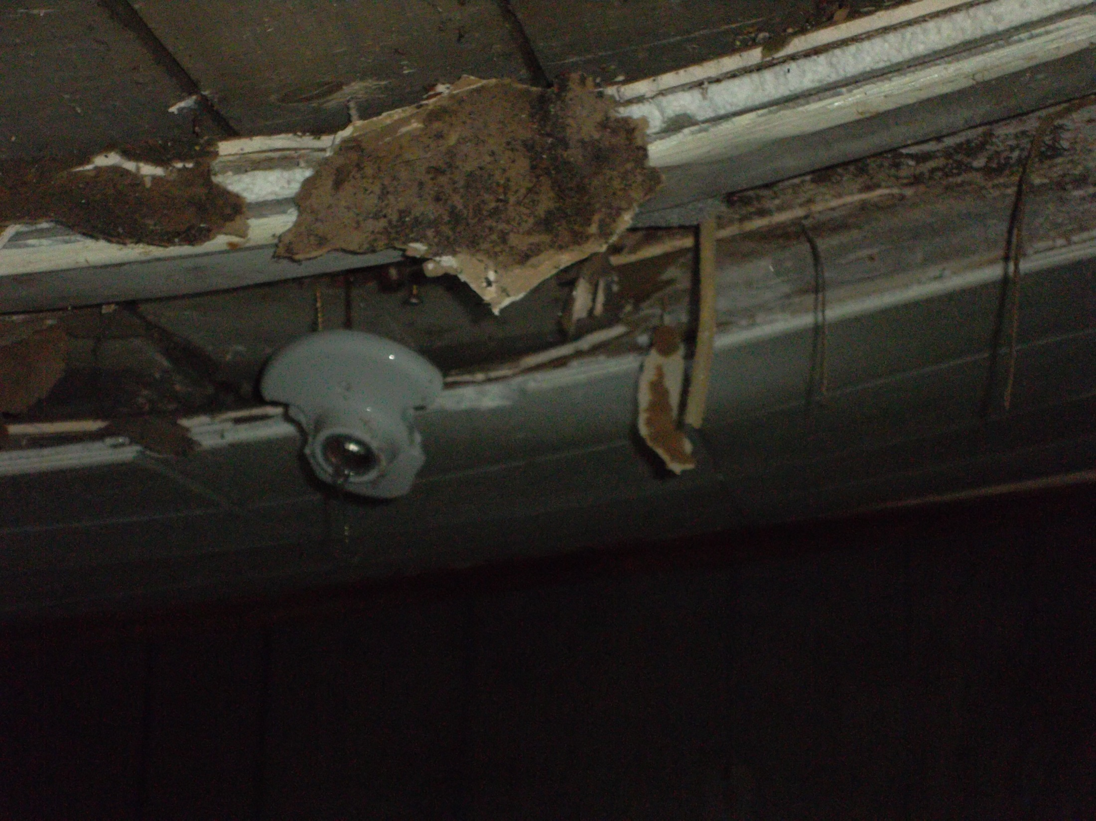
Kitchen Ceiling/Light

Slide 21
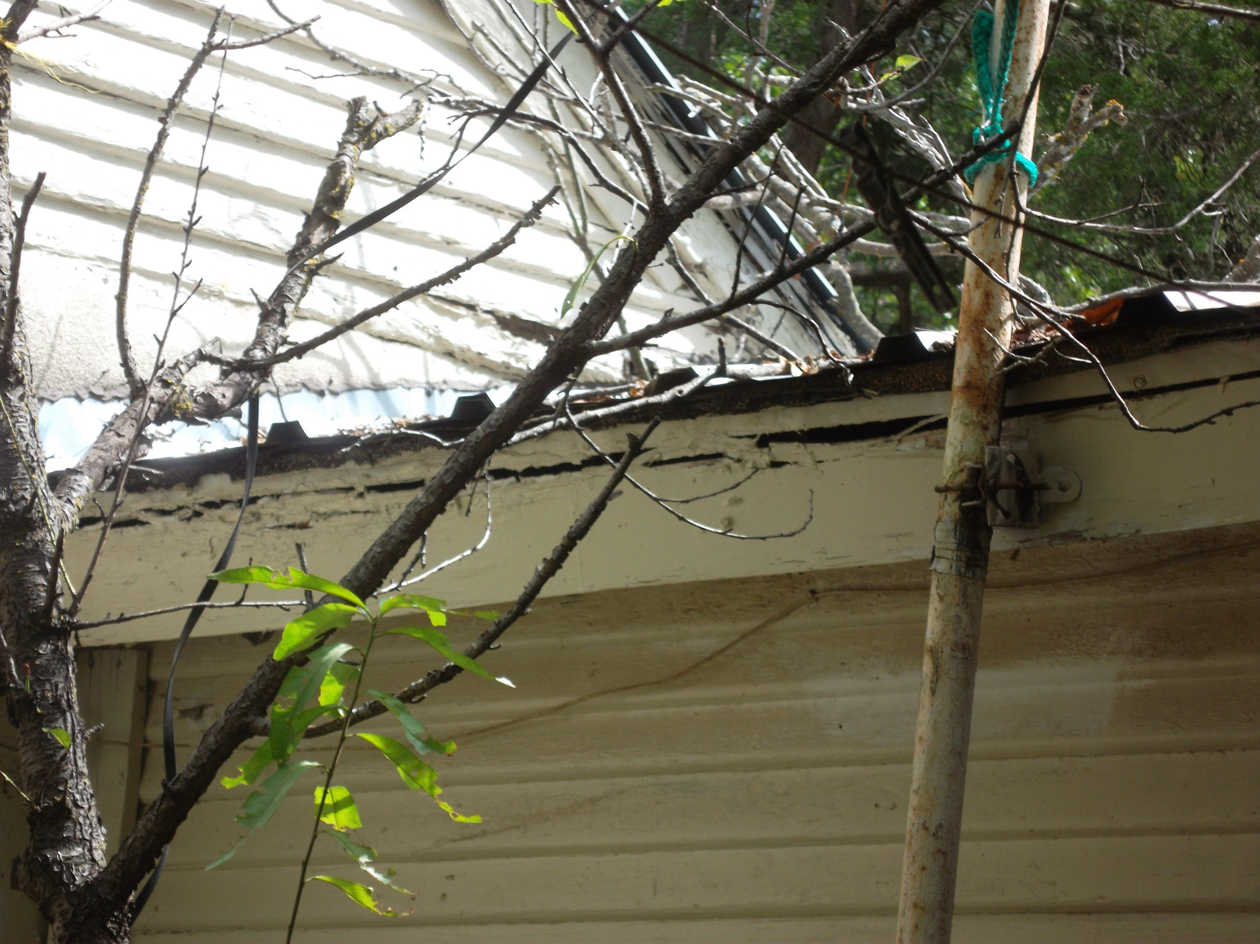
Rotting Wood on outside

Slide 22
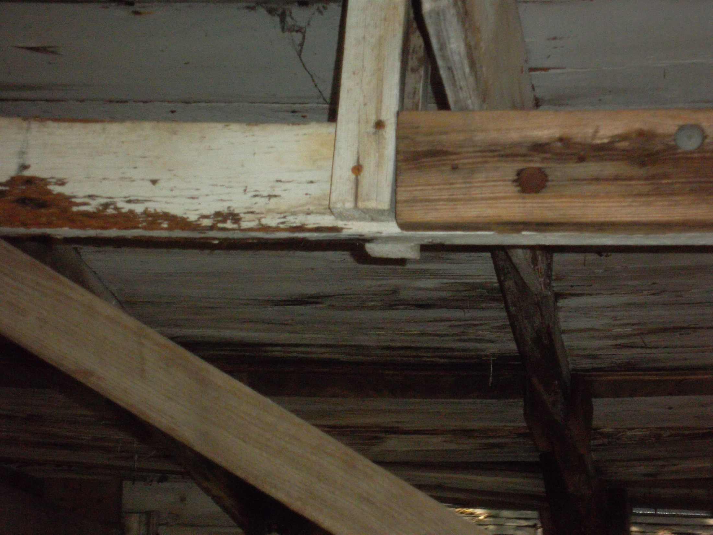
Carport Roof/Rotting Wood

Slide 23
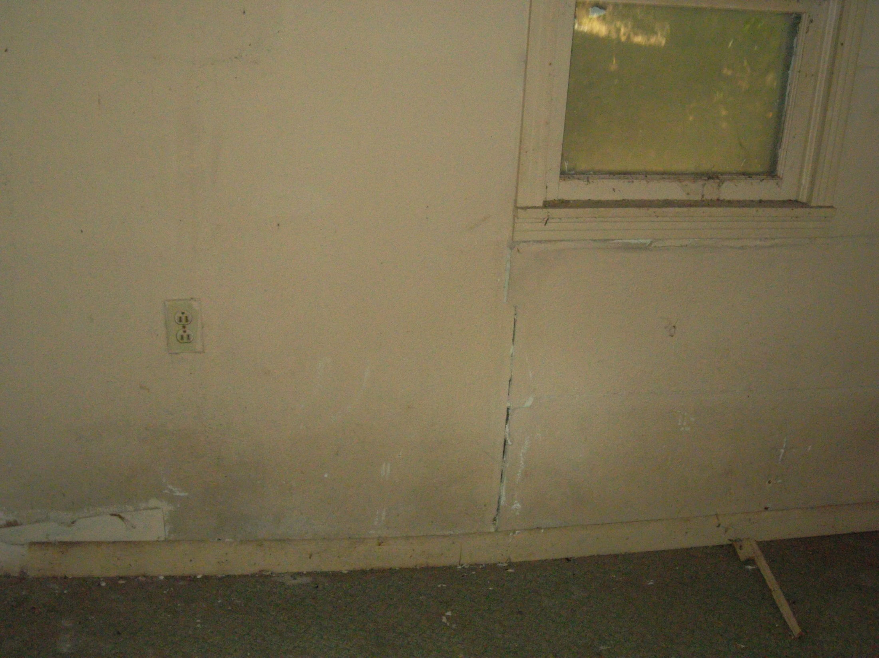
Front Bedroom

